Slide 1




PageRank Algorithm for Web Indexing
LA PROJECT

Slide 2
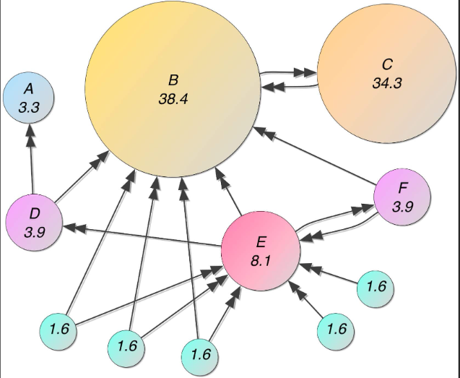
1
INTRODUCTION
Google PageRank is an algorithm developed by Larry Page and Sergey Brin, the founders of Google, to measure the importance and relevance of web pages. It was one of the key factors
that contributed to Google’s early
success as a search engine.
In essence, PageRank treats a link from one page to another as a vote of confidence or endorsement and this is how it assists in web indexing.

Slide 3
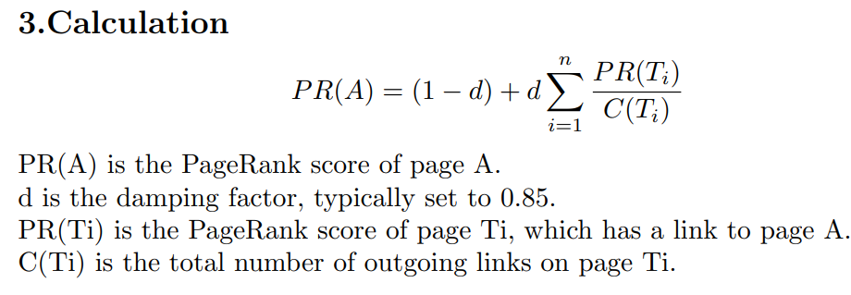
How PageRank works?
2
The algorithm works by iteratively calculating the PageRank scores for all web pages in a large graph of interconnected pages. Initially, each page is assigned an equal score. In each iteration, the PageRank score of a page is updated based on the scores of the pages that link to it. Pages with higher scores are considered more important and influential.
PageRank also takes into account the concept of "damping factor" or "random surfer model." It assumes that a user randomly clicks on links while browsing the web and incorporates this randomness into the calculation. This helps prevent manipulation and ensures a more accurate representation of a page's importance.

Slide 4
Utilization of linear Algebra
Matrix representation: The web graph can be represented as a directed graph, where web pages are represented as nodes, and the links between them are represented as directed edges. This graph can be transformed into a matrix called the link matrix or transition matrix.
Eigenvector Calculation
The PageRank algorithm involves finding the principal eigenvector of the link matrix. The principal eigenvector corresponds to the PageRank vector corresponds to the PageRank vector, which contains the PageRank scores of all web pages.
Random Surfer Model The PageRank algorithm incorporates the concept of a random surfer who randomly clicks on links while browsing the web. This is modelled using a damping factor, typically denoted as "d” which determines its probability. The damping factor introduces a Markov chain model. Solving Linear Equations: The PageRank algorithm involves solving a system of linear equations to calculate the PageRank scores. The algorithm iteratively updates the PageRank scores until convergence is reached, providing a ranking of web pages that reflects their relative importance in the network.
Notes:
When conducting research, it is easy to go to one source: Wikipedia. However, you need to include a variety of sources in your research. Consider the following sources:
Who can I interview to get more information on the topic?
Is the topic current and will it be relevant to my audience?
What articles, blogs, and magazines may have something related to my topic?
Is there a YouTube video on the topic? If so, what is it about?
What images can I find related to the topic?

Slide 5

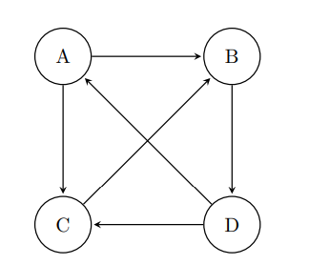
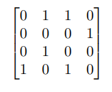
Graph Theory and Adjacency Matrix
A graph is an object that consists of a non-empty set of vertices and another set of edges.
A directed graph or digraph is a set of nodes and a collection of directed edges that each connects an ordered pair of vertices.
For any two vertices i and j of a directed graph, if there is an edge from i to j or from j and i, the two vertices are adjacent. An adjacency matrix is an n × n matrix containing 1’s in its entries on row i, column j of the matrix if there is an edge from node i to node j and 0’s otherwise.
In the above matrix we can associate Row 1 as Node A , Row 2 as Node B ,Row 3 as Node C and Row 4 as Node 4.Similarly for Columns. In the above Digraph since there is an edge between A and B so there is an entry of 1 in the A(1,2).

Slide 6
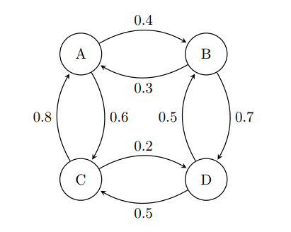
Markov Chains
A mathematical model that describes an experiment or measurement that is
performed many times in the same way, where the outcome of a given experiment
can affect the outcome of the next experiment. The process starts at an initial
state, namely x0, and transitions successively from one state to another, say
x1, x2, . . . , xk. The outcome of a given state depends only on the immediately
preceding state.
Using the above diagram as an example to illustrate the concept we can say that assuming that a person is at Node A . The probability of the person going to Node B from A is 0.4 and to Node C from A is 0.6 . It does not depend which state person was earlier than Node A.

Slide 7
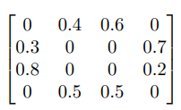
Stochastic Matrix
A transition matrix, is a special type of stochastic matrix or probability matrix which is used in Markov Chain Models, is a square matrix that represents the probabilities of transitioning between states in the Markov chain.
A column-stochastic matrix is a square matrix in which all entries are greater than or equal to zero (nonnegative) and whose columns are probability vectors.
A right stochastic matrix is a square matrix of nonnegative real numbers whose rows add up to 1.
A left stochastic matrix is a square matrix of nonnegative real numbers whose columns add up to 1.
The state matrix at state k + 1 is denoted as xk+1, while T represents the transition matrix. The state matrix at state k is denoted as xk. The equation can be written as follows:
xk+1 = T · xk
To illustrate an example of Transition Matrix using the Markov Chain Model. The Transition Matrix of the above Markov chain model is as the matrix:
In the matrix we can associate Row 1 as Node A , Row 2 as Node B ,Row 3 as Node C and Row 4 as Node 4.

Slide 8

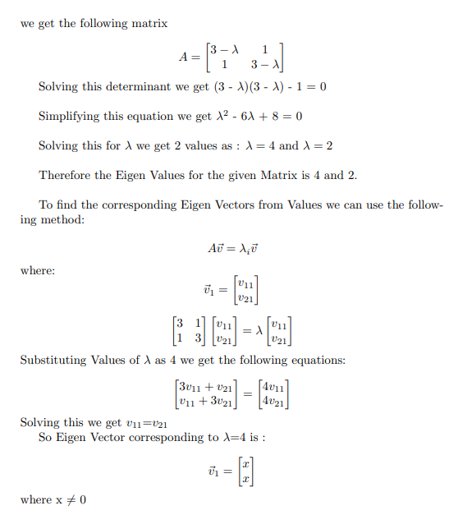
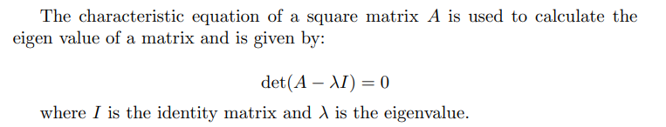
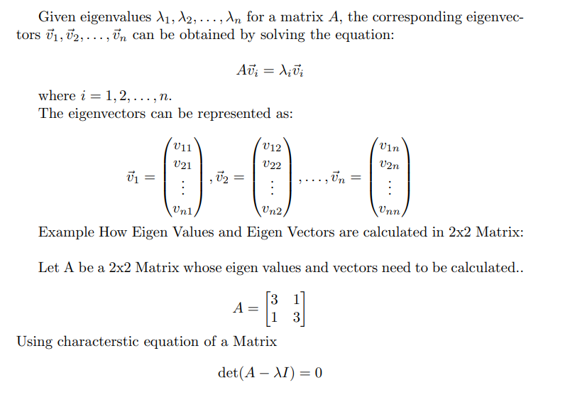
Eigen Values and Eigen Vectors

Slide 9

State of the Art Literature
In our project, we focused majorly on two research papers which were
GeneRank
Systemic Risk Measure
Both of the research papers reflected the versatility of the PageRank Algorithm and how it can be implemented across various fields and produce important results.
Here’s a brief summary:-
The ‘Gene Rank’ research paper published in 2022 provides deep insight as to how we can tweak the PageRank Algorithm to generate prioritized gene lists by exploiting biological information
The “too central to fail” systemic measure uses the PageRank Algorithm to assess the potential impact of the failure of a specific entity within a networked system. It’s a link analysis algorithm that assigns importance scores to web pages based on their connectivity and incoming links. To apply the PageRank algorithm to measure systemic risk, we need to represent the interconnectedness of entities within a system as a network. Each entity is represented as a node, and the relationships or connections between entities are represented as edges. The strength of the connections can be based on factors such as financial interdependencies, operational dependencies, or other relevant measures.
Notes:
Once you find your sources, you will want to evaluate your sources using the following questions:
Author:
Who is the author?
Why should I believe what he or she has to say on the topic?
Is the author seen as an expert on the topic? How do you know?
Current:
How current is the information in the source?
When was the source published?
Is the information out-of-date?
Accuracy:
Is the content accurate?
Is the information presented objectively? Do they share the pros and cons?

Slide 10
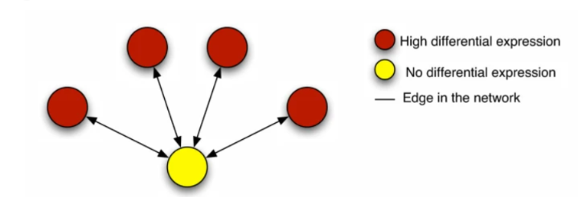

GeneRank
While PageRank uses hyperlinks between web pages, Gene Rank combines the expression measurements with external information, such as functional annotations, protein interaction data or previous experimental results. The PageRank algorithm, used by the successful search engine Google, is based on the premise that a web page should be highly ranked if other highly ranked pages contain hyperlinks to it.
This idea naturally extends to analyzing the results of a microarray experiment, where we would like a gene to be highly ranked if it is linked to other highly ranked genes, even if its own position is lower. We can think of this as the "vote of confidence" principle.
The algorithm views the web as a directed graph G(V, E), where the N nodes V are the web pages and the edges E represent the links between pages. This information can be stored in an adjacency matrix, W ∈ R^N × N, where w ij = 1 if there is a link from page i to page j and w ij = 0 otherwise.
d= 0.85 is the value which is used by google.
From the above formula, it is clear that the rank of a page depends on the rank of all pages that are linked to it.
Multiplying by 1/degi ensures that each page has equal influence in the voting procedure.
Each page gets a rank of 1 - d automatically and also gets d times the votes given by other pages.
Notes:
After consulting a variety of sources, you will need to narrow your topic. For example, the topic of internet safety is huge, but you could narrow that topic to include internet safety in regards to social media apps that teenagers are using heavily. A topic like that is more specific and will be relevant to your peers. Some questions to think about to help you narrow your topic:
What topics of the research interest me the most?
What topics of the research will interest my audience the most?
What topics will the audience find more engaging? Shocking? Inspiring?

Slide 11
Systemic Risk Measure
Systemic Risk Measure is basically based on the fact that if institutions, deeply connected to many other institutions, have to face a loss then the connected institutions have to face a great loss too.
The "Too Central to Fail" (TCF) systemic risk measure using the PageRank algorithm is a method to assess the potential impact of the failure of a specific entity within a networked system.
To apply the PageRank algorithm to measure systemic risk, we need to represent the interconnectedness of entities within a system as a network. Each entity is represented as a node, and the relationships or connections between entities are represented as edges. The strength of the connections can be based on factors such as financial interdependencies, operational dependencies, or other relevant measures.
By applying the PageRank algorithm to the network representing the interconnectedness of entities, the TCF systemic risk measure provides a quantitative assessment of the potential systemic risk associated with each entity. This measure can help policymakers, regulators, and financial institutions in identifying and addressing the risks posed by highly interconnected entities within a system.
The basic steps followed are similar to the PageRank Algorithm, which involves defining the network, assigning initial scores, iterative computation, convergence of the results and the final calculation of the TCF measure.
Notes:
Now, that you have narrowed your topic, you will want to organize your research in a structure that works. There are some common organizational patterns based on the kind of research you are doing.
Organizational Structures:
Cause and Effect- this kind of structure is great for explaining the causes and effects of a topic
Compare and Contrast- in this pattern you highlight the similarities and differences of the topic
Explain process- this structure is great for outlining a series of steps to follow;
Definition- if you want to make sure your audience understands what something is using illustrations, meanings, clarifying misconceptions, you may want to use this structure
Classification- a common organizational structure is grouping like topics or facts from the research together. For instance, in the internet safety about social media apps, you may organize the research where you look at each social media app one at a time

Slide 12
Other Applications
ProteinRank:
The goal of ProteinRank is similar in spirit to that of GeneRank. Given an undirected network of protein-protein interactions and human-curated functional annotations about what these proteins do, the goal is to find proteins that may share a functional annotation. Thus, the PageRank problem is, again, a localized use.
ItemRank:
A recommender system attempts to predict what its users will do based on their past behavior. Netflix and Amazon have some of the most famous recommendation systems that predict movies and products, respectively, that their users will enjoy. Localized PageRank helps to score potential predictions in many research studies on recommender systems.
Notes:
After you’ve done your research, it’s time to put your presentation together. The first step in the process is to introduce the topic. This is a great time to connect your topic to something that your audience can relate. In other words, why should they listen to all the information you will be sharing in your research presentation? What is in it for them? You may also want to include a graphic or image to grab their attention.
Feel free to duplicate this slide by right-clicking on this slide in the slides pane to the left and select Duplicate Slide.
The next step in your presentation is to state your claim or topic clearly. Your teacher may even call this your thesis. As you state your thesis, you may find that this layout is not the best layout for your claim or topic. You can change the layout by clicking the drop-down menu next to the Layout in the Slides menu section. You can choose Two Content, Comparison, or Picture with Caption. Note: A different layout might change the look of the icons on this page.
You will also want to state your facts. You have done the research now share some of the interesting facts with your audience. Facts do not have to be boring; you can communicate facts in a variety of ways by going to the Insert Tab. In the Insert tab you can:
Insert pictures from your computer or online.
Add a chart
Create some SmartArt
Insert a variety of icons to help your facts come to life. Note: You can change the color of the icons by selecting the icon and then click on the Format tab and then Graphics Fill. From there, you will choose a color from the list or choose More Fill Colors to give you more options.
Since this research presentation is a result of your hard work and searching, you want to make sure you support the claims or points in your presentation with facts from your research findings. Make sure you give the author proper credit for helping you share your ideas. If one of your sources has a video that is relevant to your topic, you can add the video as added support. Keep in mind the length of the video and the amount of time you have for your presentation. For a 5 minute speech, the video should be no longer than 30 seconds.
Questions to consider:
How will you state the author of the source?
Will you need to cite the source on the slide?
What are some ways you can engage your audience so they feel like they are a part of the presentation? Some ideas to consider is by taking a quick poll like: by a show of hands, how many of you think school uniforms are a way to cut down on bullying? Another suggestion is to have them hold up a certain number of fingers to see if they agree or disagree. Finally, you can share a story that the audience can relate to that makes them laugh.
After all the applause, your audience may have some questions. Be prepared to answer some of their questions by making a list of questions you think they might ask. You may also want to share the presentation with them by providing the link to your presentation, if they want more information.

Slide 13
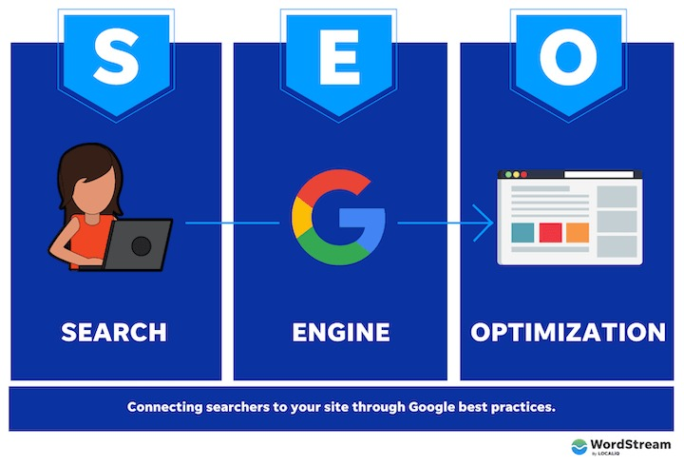
SEO: Search Engine Optimization and their story with PageRank.
SEO is the Search Engine Optimization. It can be called a process and a job title.
Now they are obsessed with PageRank. We say this for a reason. SEOs to increase the PageRank score of their page, will manipulate it by going to any lengths.
They do this by filling up their page with more links, especially those from popular pages. To get away with it the links will be hidden or really small to notice. But they can affect the PageRank immensely
But now comes the question, ‘How could they possibly know what their PageRank score is?’ They knew it because Google had released a toolbar encasing this feature to view the PageRank of their page. This was the public-facing metric.
So as we can see, we can deduce that PageRank which was to increase the efficiency of search engines had become a factor of manipulation. So gradually Google had lost it’s confidence in PageRank. It had to do something. This was getting problematic.
Thus google decided to take down the toolbar! The menace was taken care of. They still use the PageRank but far from the public view and altered into a far better version.

Slide 14
Contributions:
• Sanchit contributed towards the writing document on LaTeX. Found how the algorithm works and the application of Linear Algebra in it. Also explained the concepts of Linear Algebra briefly.
• Kripi Singla also did research on working of algorithm and application of Linear Algebra . Also worked on SOTA part for Gene Rank and the presentation.
• R. Shaanal worked on SOTA part for Too Central To fail, about SEO’s story and also worked a little on the presentation.

Slide 15
-That Marks the End-
THANK YOU!!
Notes:
You can use this slide as your opening or closing slide. Should you choose to use it as a closing, make sure you review the main points of your presentation. One creative way to do that is by adding animations to the various graphics on a slide. This slide has 4 different graphics, and, when you view the slideshow, you will see that you can click to reveal the next graphic. Similarly, as you review the main topics in your presentation, you may want each point to show up when you are addressing that topic.
Add animation to images and graphics:
Select your image or graphic.
Click on the Animations tab.
Choose from the options. The animation for this slide is “Split”. The drop-down menu in the Animation section gives even more animations you can use.
If you have multiple graphics or images, you will see a number appear next to it that notes the order of the animations.
Note: You will want to choose the animations carefully. You do not want to make your audience dizzy from your presentation.

